Slide 1
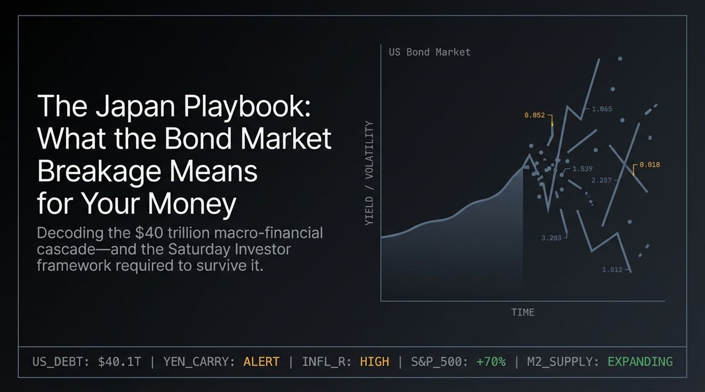
Notes:
Welcome, everyone. Today, we are opening up a conversation about one of the most critical macro-financial shifts of our lifetime: what we call The Japan Playbook.
Right now, we are witnessing a fundamental break in the economic reality we’ve relied on for decades. Look at the ticker across the top of this slide: US national debt is fast approaching a staggering $40 Trillion tipping point. At the same time, the Yen carry trade is flashing warning signs, inflation remains stubbornly sticky, and while the S&P 500 is up 70% over the last three years, most working people feel like they are falling behind.
In this session, we're going to break down why the bond market has stopped trusting government spending, how the US is adopting the exact monetary playbook Japan has used for 30 years, and—most importantly—how you can use the Saturday Investor framework to protect your purchasing power and thrive in an era of persistent money printing.
https://www.youtube.com/watch?v=Si52BL8HAYI

Slide 2
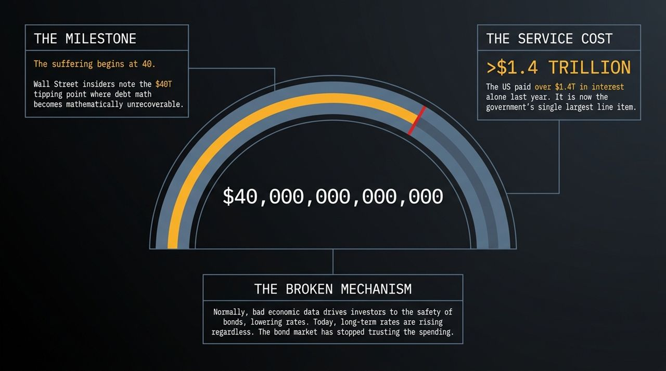
Notes:
Wall Street insiders often reference a specific threshold: $40 Trillion. They call it the tipping point where debt math becomes mathematically unrecoverable.
Let’s talk about what broke in the bond market. Under normal economic rules, when you get bad economic news or weak jobs data, investors run to safety. They buy long-term US bonds, which pushes bond prices up and brings interest rates down. But today, long-term interest rates are rising despite economic uncertainty. Why? Because the bond market—the smartest, most disciplined money on Wall Street—has stopped trusting government spending.
Look at the service cost: The US paid over $1.4 Trillion in interest alone last year. Interest payment is now the single largest line item in the federal budget—exceeding defense spending. When rates rise further, that interest cost expands exponentially. When you reach this level of debt math, hard defaults are politically off the table. Instead, the system relies on a soft default: inflating the debt away.

Slide 3
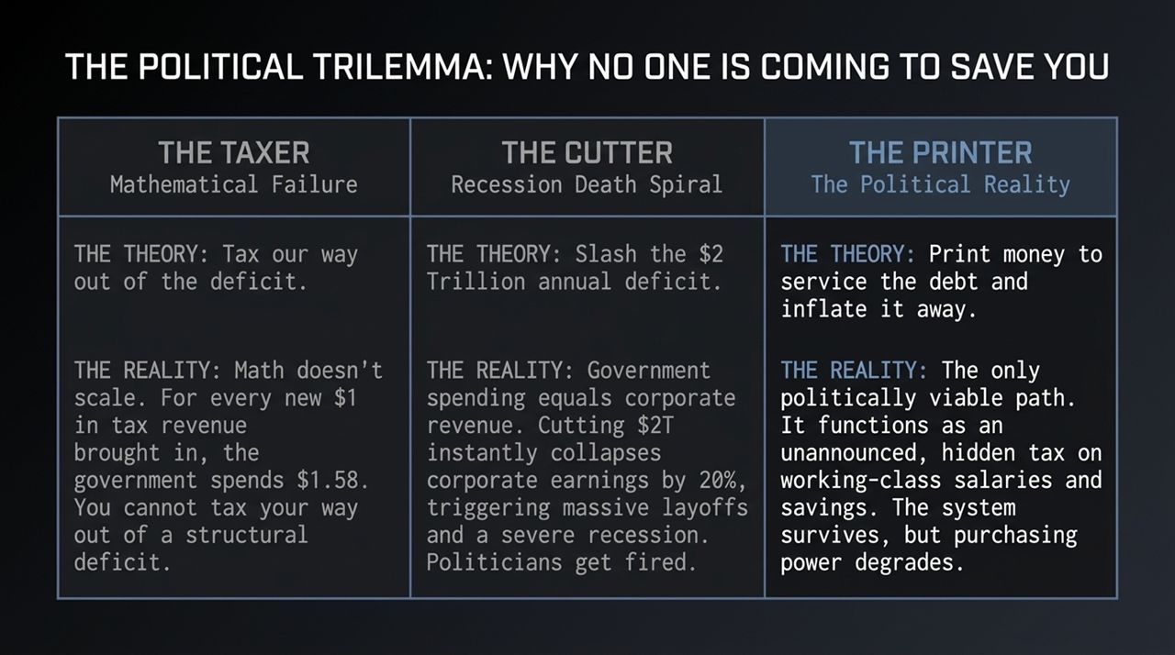
Notes:
When facing a $2 Trillion annual structural deficit, voters assume politicians will solve it. But as investors, we must realize that no politician is coming to save you, regardless of party. There are only three potential paths, and two of them are political non-starters:
The Taxer: The theory is to tax our way out of the deficit. The math fails. For every new $1 in tax revenue brought in historically, government spending expands by $1.58. You cannot tax your way out of a structural spending problem.
The Cutter: The theory is to slash $2 Trillion in federal spending. But government spending is corporate revenue. Cutting $2 Trillion immediately collapses corporate earnings by up to 20%, triggers widespread layoffs, and plunges the economy into a severe recession. Politicians who cut spending at that scale get fired immediately.
The Printer: This leaves option three—the only politically viable path. Print money to service the debt and inflate it away. It acts as an unannounced, stealth tax on salaries and cash savings. The sovereign state survives, but purchasing power degrades.

Slide 4
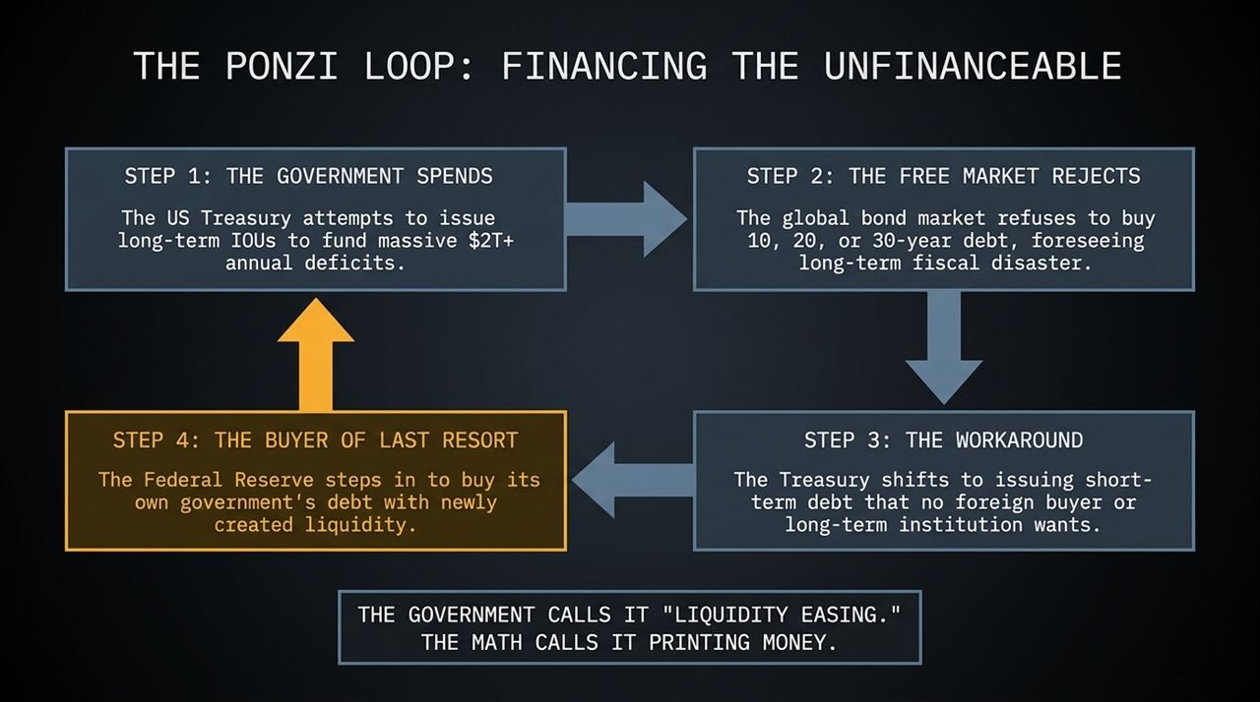
Notes:
Because the government cannot balance its books, it enters what we call The Ponzi Loop:
Step 1: The US Treasury attempts to issue 10-, 20-, and 30-year bonds to finance $2T+ annual deficits.
Step 2: The free market rejects long-term bonds. Foreign central banks and private investors refuse to lock in low yields on 30-year debt when they anticipate long-term fiscal dilution.
Step 3: The Treasury pivots by issuing massive volumes of short-term Treasury bills (IOUs).
Step 4: The Fed acts as the ultimate buyer of last resort, absorbing this short-term debt using newly created liquidity.
Wall Street and central banks don't like to call this 'money printing'. They invent fancy euphemisms like 'Liquidity Easing' or 'Balance Sheet Management'. But the underlying math is simple: it is pure money creation to keep rates artificially suppressed.

Slide 5
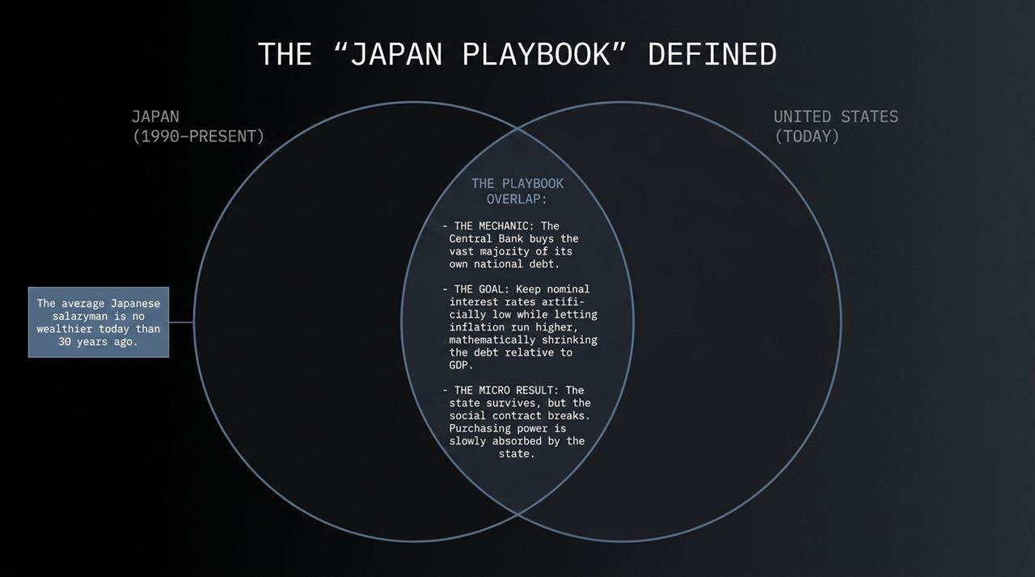
Notes:
This leads us to the heart of the presentation: The Japan Playbook.
Following their asset bubble burst in 1989-1990, Japan spent over three decades running this exact script. To keep nominal interest rates artificially low while supporting staggering debt-to-GDP ratios (over 230%), the Bank of Japan stepped in to buy up the vast majority of its own national debt.
The Goal: Keep nominal interest rates low while allowing inflation to run higher, mathematically shrinking the value of the debt relative to total GDP over time.
The Micro Result: The central government stays solvent, but the social contract breaks. The average Japanese salaryman is no wealthier today in real terms than 30 years ago. Purchasing power was slowly absorbed by the state to support sovereign debt. The US is now executing this exact playbook.

Slide 6
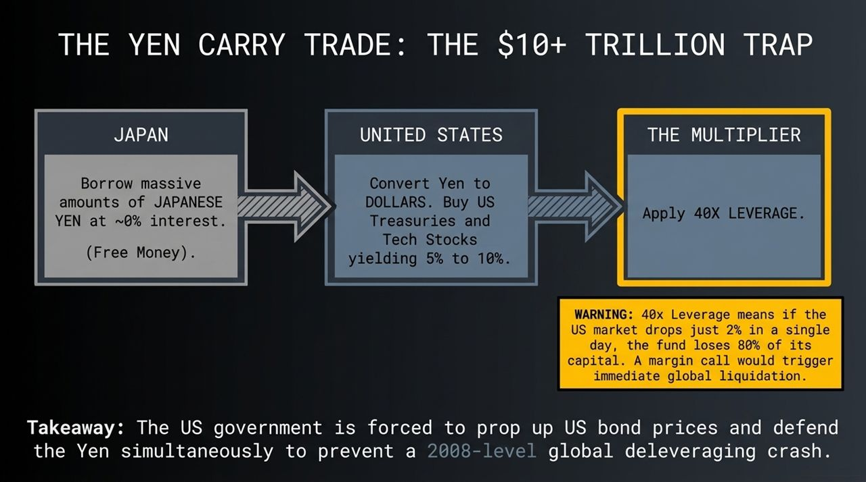
Notes:
Understanding the US debt crisis requires understanding the Yen Carry Trade—a financial mechanism estimated between $10 Trillion and $30 Trillion.
For decades, global hedge funds borrowed massive amounts of Japanese Yen at near 0% interest. They converted those Yen into US Dollars to buy higher-yielding US Treasuries and Mega-Cap Tech stocks yielding 5% to 10%.
The danger is leverage. Financial institutions often leveraged these positions 20x to 40x. At 40x leverage, if US markets drop just 2% in a single day, or if the Yen rapidly appreciates, the fund suffers an 80% capital loss—triggering instant margin calls and forced liquidation.
This is why the US Treasury is actively forced to prop up US bond prices while managing the Yen simultaneously. An uncontrolled unwinding of the carry trade risks triggering a 2008-level global liquidation event.

Slide 7
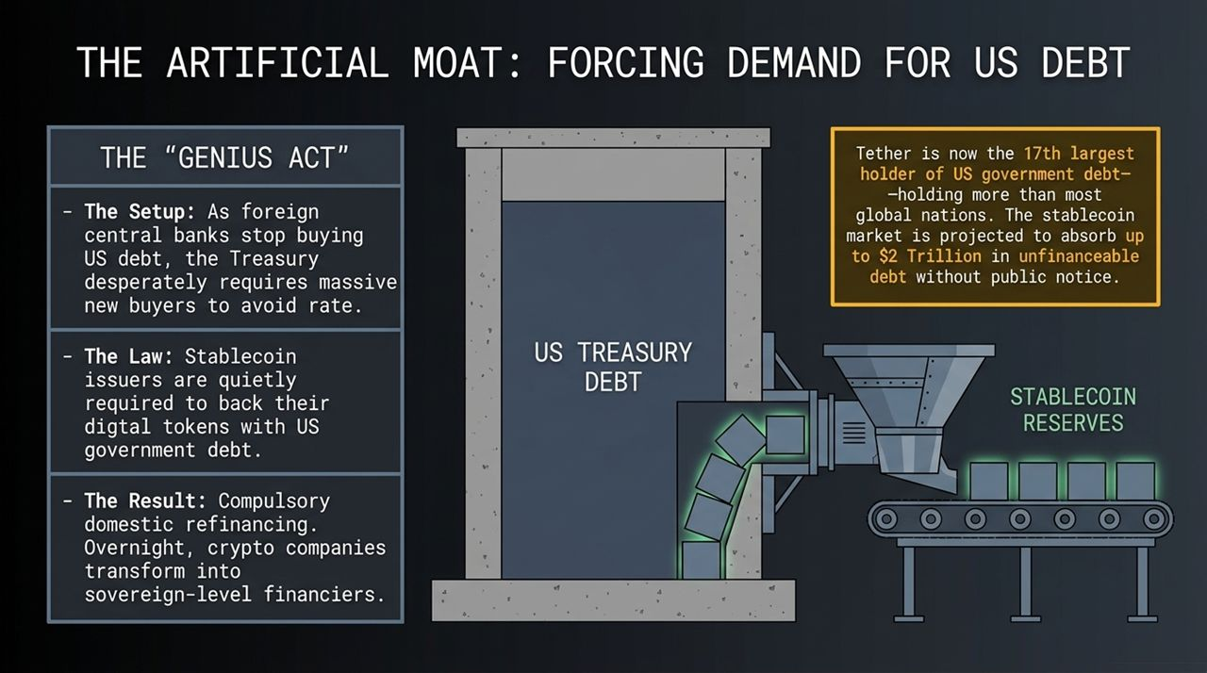
Notes:
As foreign central banks reduce their purchases of US Treasuries, the Treasury needs a new source of domestic demand. Enter the GENIUS Act and the stablecoin market.
Under the guise of crypto regulation, stablecoin issuers like Tether and Circle are required by law to back digital tokens with short-term US government debt. Stablecoin issuers retain the 4% to 5% yield without passing interest on to users, making it wildly profitable for them while creating compulsory domestic refinancing for the US government.
Overnight, stablecoin companies have transformed into sovereign-level financiers. Tether alone is now the 17th largest holder of US government debt—holding more US Treasuries than many major nations. The stablecoin sector is projected to absorb up to $2 Trillion in unfinanceable national debt.

Slide 8
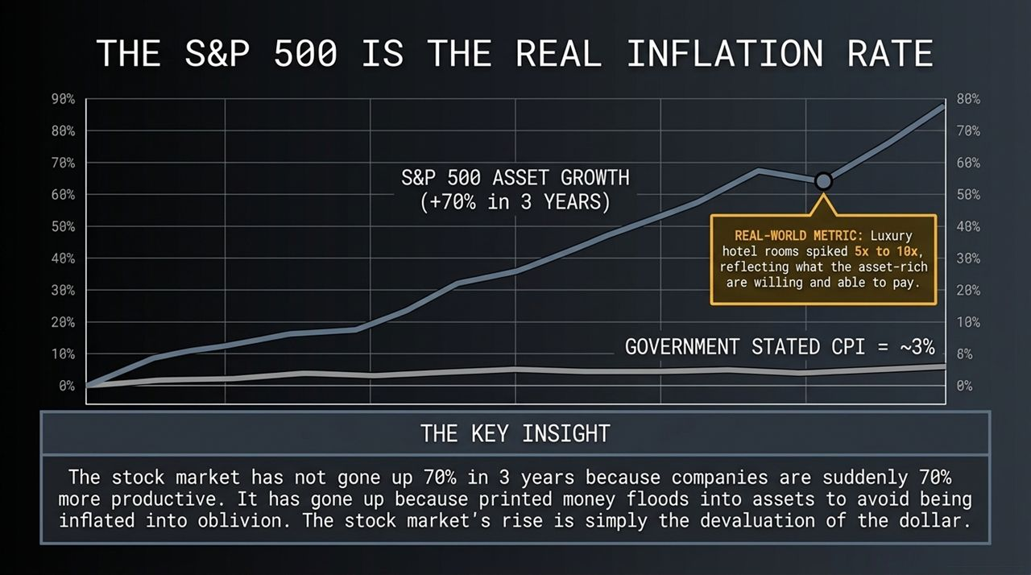
Notes:
Government statistics report Consumer Price Index (CPI) inflation around 3%. But stated CPI numbers rely on hedonic adjustments and substitution models.
Look at real-world benchmarks:
Luxury hotel room rates have surged 5x to 10x over recent years, reflecting what asset-rich individuals are able and willing to pay.
The S&P 500 is up 70% in 3 years.
The Key Insight: The stock market did not rise 70% because corporations suddenly became 70% more productive. Roughly 80% of market expansion is simply printed money flooding into financial assets to avoid dollar devaluations. The stock market's rise is largely the inverse reflection of a declining dollar.

Slide 9
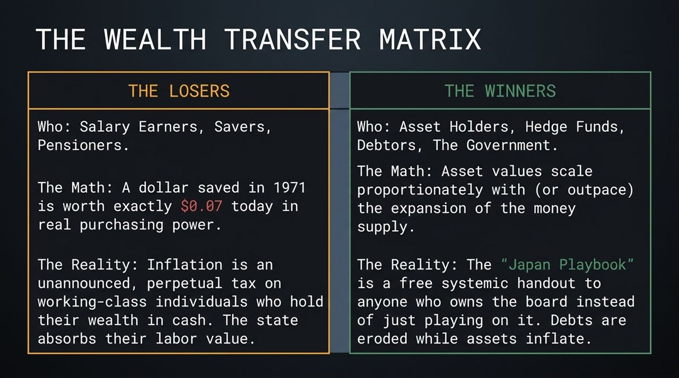
Notes:
When a central bank uses monetary expansion to solve sovereign debt, it creates a structured transfer of wealth:
The Losers: Salary earners, cash savers, and pensioners on fixed incomes. A US dollar saved in cash in 1971 retains roughly $0.07 in purchasing power today. Inflation acts as an unannounced tax, absorbing labor value from those holding cash.
The Winners: Asset owners, hedge funds, sovereign debtors, and prime asset holders. Asset prices expand alongside money supply expansion. Debtors pay off old fixed-rate liabilities with inflated dollars, while their physical and equity assets appreciate.
The takeaway: The Japan Playbook is a handout to those who own the board rather than those who just play on it.

Slide 10
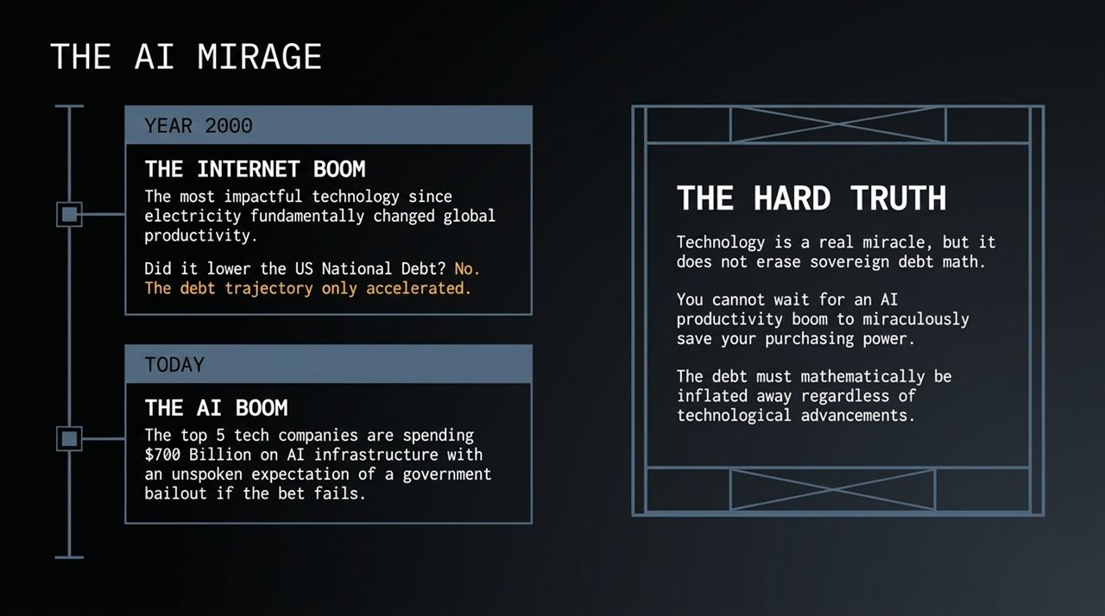
Notes:
Many tech investors argue: 'AI productivity will generate so much economic growth that it will outpace the national debt.'
Let's look at recent history:
Year 2000 (The Internet Boom): The internet was the most transformative productivity tool since electricity. Did it reduce US National Debt? No, debt growth accelerated.
Today (The AI Boom): Top tech companies are committing over $700 Billion toward AI capital expenditures.
Technology creates genuine efficiency, but it cannot erase structural debt math. You cannot rely on an AI boom alone to preserve cash purchasing power when currency supply is expanding faster than economic growth.

Slide 11
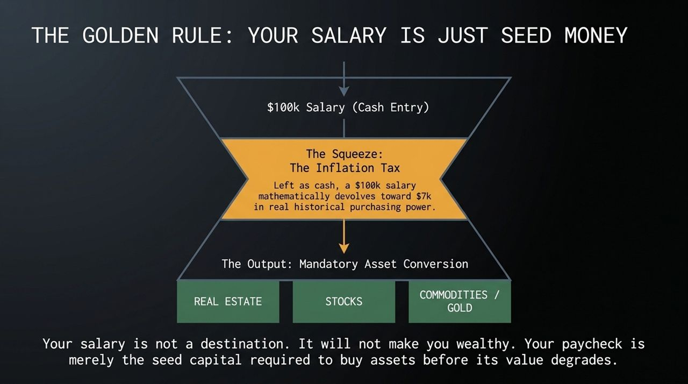
Notes:
Here is the fundamental rule for surviving this paradigm shift: Your salary is not your wealth. Your salary is seed capital.
If a high-earner makes $100,000 and leaves it in cash, inflation devalues that capital over time.
The objective of earning income in an inflationary environment is immediate conversion into productive assets—real estate, broad equities, and hard assets. You must convert fiat paychecks into ownership stakes before purchasing power degrades.
Warning: Standard 401(k) allocations and broad index funds often carry over 50% implicit exposure to Tech and AI. During the dot-com unwinding, tech indices dropped 78%. Diversify across structural economic drivers, not just ticker symbols.

Slide 12
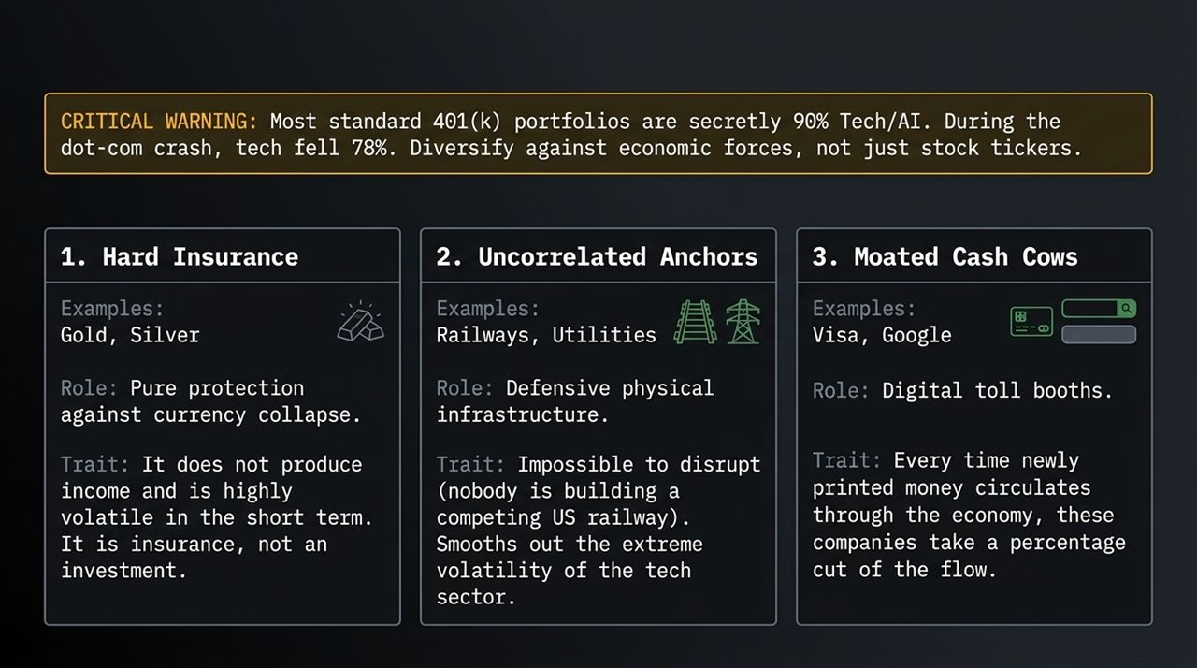
Notes:
To insulate capital against monetary expansion and volatility, institutional funds structure portfolios across three core pillars:
Hard Insurance (Gold & Silver): Gold does not generate income and fluctuates based on short-term market speculation. However, it acts as a non-counterparty reserve asset against currency devaluation. It is financial insurance, not a yield instrument.
Uncorrelated Anchors (Railways & Utilities): Physical infrastructure assets with structural moats. Competitors cannot construct parallel transcontinental railway lines. These assets provide cash flows and reduce tech-sector volatility.
Moated Cash Cows (Visa, Mastercard, Alphabet): Digital tollbooths. Every time inflated dollars circulate through consumer networks, these platforms take a transactional cut. Their revenues scale naturally alongside nominal money flows.

Slide 13
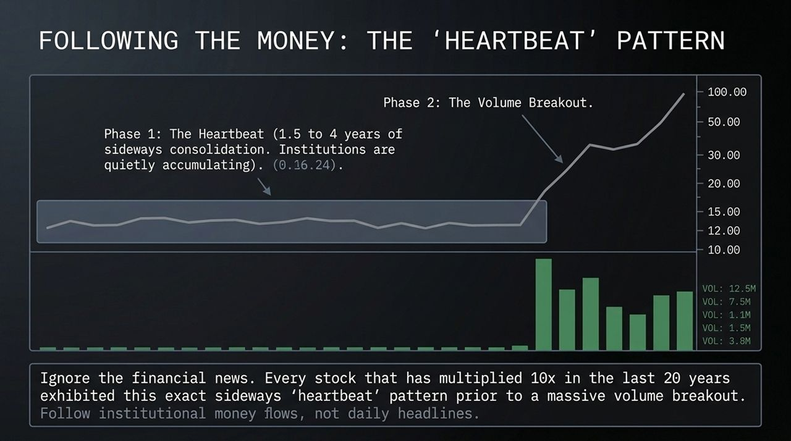
Notes:
When institutional money enters an asset class, it leaves structural footprints on price charts.
Over a 20-year multi-bagger study, major 10x market leaders demonstrated a consistent structural setup before major upward trends:
Phase 1: The Heartbeat: A sideways consolidation range lasting 1.5 to 4 years. During this period, institutional capital quietly accumulates positions without spiking public market prices.
Phase 2: Volume Breakout: Price breaks above multi-year resistance levels accompanied by institutional buying volume.
Rather than acting on daily news headlines, monitor capital flows and consolidation patterns where smart money accumulates positions prior to broader public adoption.

Slide 14
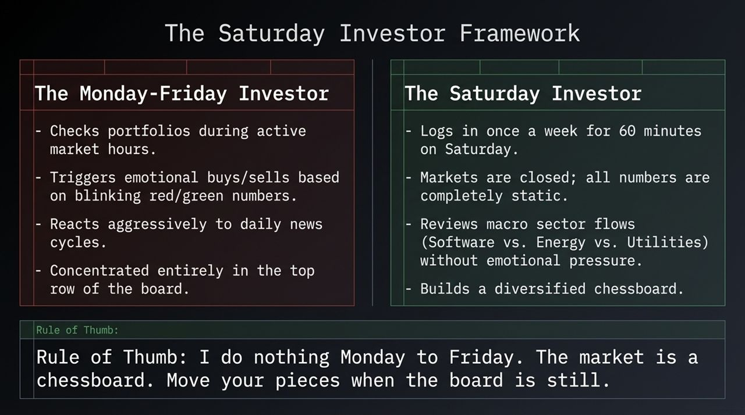
Notes:
The difference between retail trading losses and institutional risk management comes down to emotional discipline:
The Monday–Friday Investor: Monitors accounts during active market hours. Triggers impulse transactions based on daily price ticks and headlines. Focuses heavily on narrow high-beta tech tickers.
The Saturday Investor: Reviews portfolio positioning once per week for 60 minutes on Saturday. Because exchanges are closed, prices are completely static. This enables objective evaluation of sector allocations (e.g., Software vs. Energy vs. Utilities) free from active trading noise.
Rule of Thumb: Make strategic asset allocation decisions when markets are still.

Slide 15
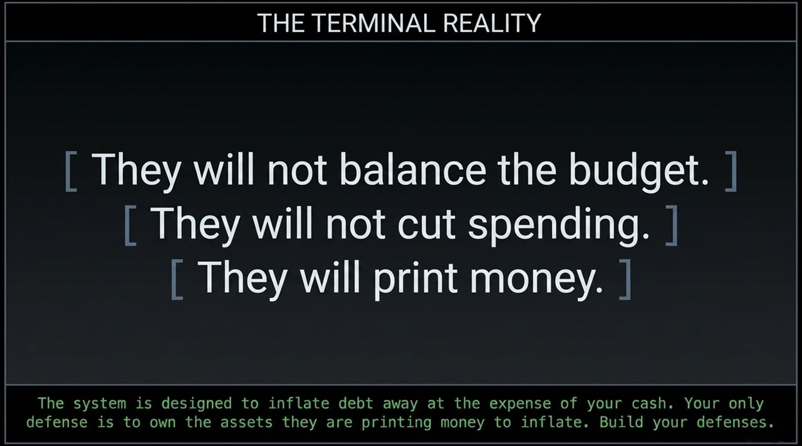
Notes:
To navigate the coming decade, we must accept three realities:
Governments will not balance structural budgets.
Governments will not execute meaningful spending cuts.
Central banks will resort to monetary expansion to service sovereign obligations.
The system is structurally incentivized to inflate away sovereign obligations. Trying to fight this reality by holding excess uninvested cash guarantees purchasing power erosion. Defense requires owning productive, inflation-resilient assets.

Slide 16
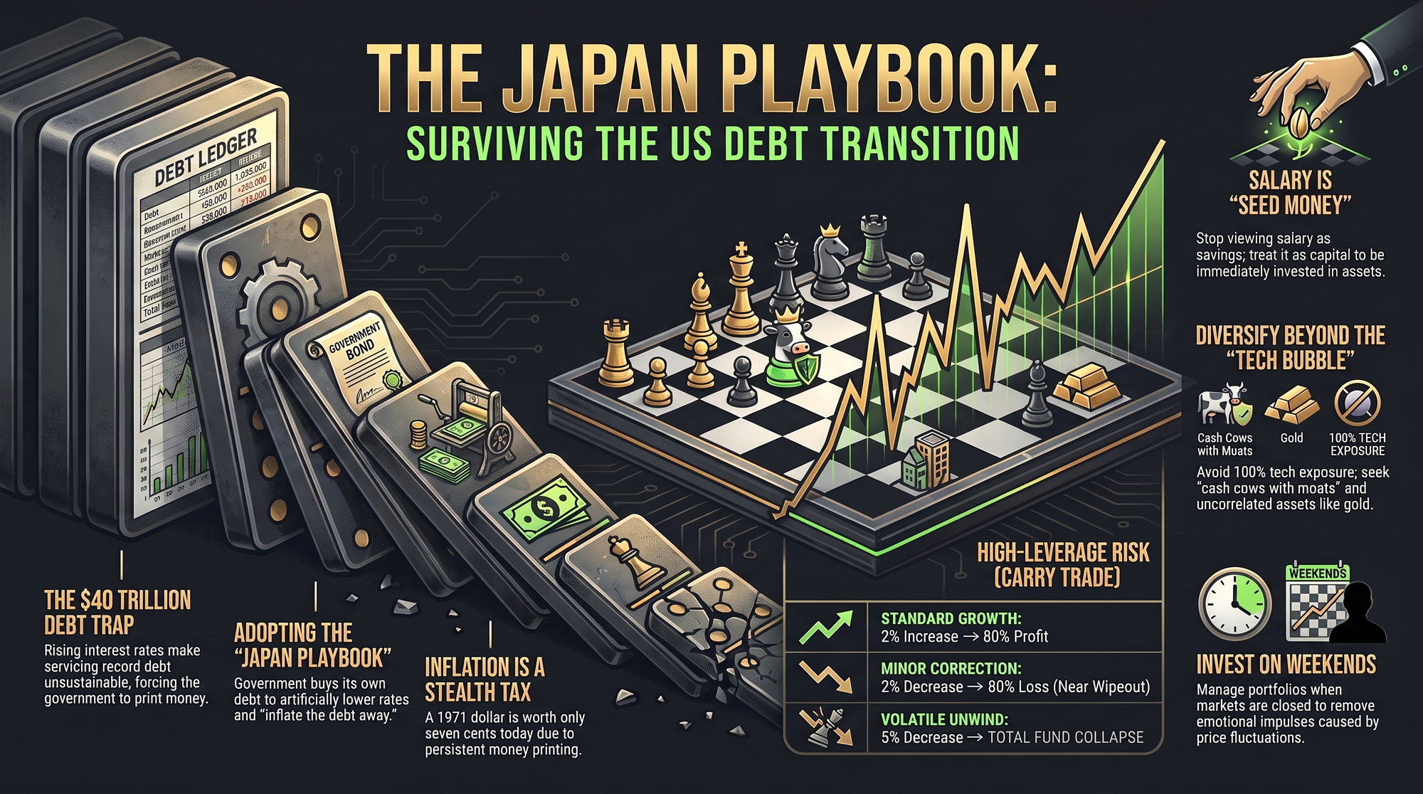
Notes:
To conclude Slide 1 to 16, here is your executive summary action map:
Treat Salary as Capital: View paychecks as seed capital to be converted into productive assets.
Diversify Portfolio Drivers: Reduce over-concentration in pure tech/AI; incorporate cash-cow businesses with moats and hard assets.
Understand the Macro Environment: Recognizing sovereign debt constraints helps explain central bank market interventions.
Recognize Monetary Policy Shifts: Monitor central bank balance sheets as they absorb debt issuance.
Protect Against Inflation: Cash holdings incur an implicit purchasing power tax during period of monetary expansion.
Execute on Weekends: Conduct portfolio reviews when markets are closed to eliminate impulsive, news-driven trades.
Thank you. Let's open up the floor for Q&A.

